Slide 1
Computer systems Organization
Subroutines in ARM -- Spring 2010 -- IIIT-H -- Suresh Purini

Slide 2
Subroutines, Procedures and Functions
Subroutines, Procedures and Functions – Are they any different?
Why Procedures?
Avoid duplication of code within the same program.
Reuse of code across different programs (Libraries?)
Decomposition of a Complex Program into a set of more manageable subroutines.
Information Hiding.
….
Any Disadvantages?

Slide 3
Implementing Subroutine Abstraction in ARM
Question: Can we implement subroutines in ARM using the instructions we have seen so far (ignoring the BL instruction)?
main()
{
int i, sum = 0;
for(i =0; i<100; ++i )
sum = sum +sqr(i);
}
int sqr(int n )
{
return n*n;
}
Questions:
How to implement Control Transfer?
How to pass Parameters?
How to pass back Return Values?

Slide 4
Subroutines – Implementing Control Transfer
main:
.
.
.
b sum
label:
.
.
.
sum:
.
.
.
b label
Questions:
What is the problem with this approach?
How can it be resolved?

Slide 5

Subroutines – Implementing Control Transfer
main:
.
.
.
bl sum ; branch to sum
. ; return here
.
.
sum:
.
.
.
mov pc, lr ; return
Return address will be stored in the Link Register r14 (lr).
B and BL Instruction Format

Slide 6
Subroutines – Implementing Control Transfer
main() {
int i, sum = 0;
for(i =0; i<100; ++i )
sum = sum +sqr(i);
}
int sqr(int n ) {
return mult(n, n);
}
int mult(int a, int b){
return a*b;
}
main:
.
.
.
bl sum ; branch to sum
. ; return here
.
.
sum:
.
bl mult ; branch to mult
.
.
mov pc, lr ; return
mult:
.
.
mov pc, lr ; return
Does this program work ?

Slide 7
Stacks and Subroutines – Implementing Control Transfer
main:
.
.
sub sp, sp, #4
str lr, [sp]
bl sum
ldr lr, [sp]
add sp, sp, #4
.
.
sum: .
.
sub sp, sp, #4
str lr, [sp]
bl mult ; branch to mult
ldr lr, [sp]
add sp, sp, #4
.
.
mov pc, lr ; return
mult:
.
.
mov pc, lr ; return
Subroutine Calling Sequence:
Store the Link Register on the stack and adjust the stack Pointer
Call the Procedure
Pop the contents of the Link Register back from the stack and adjust the stack pointer.
Caller
Agreement: Callee promises Caller to preserve the lr, sp and also the stack contents.
Callee

Slide 8
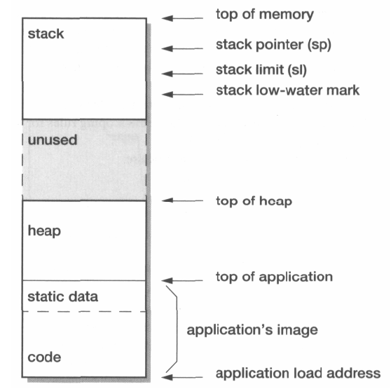
Subroutines – Implementing Control Transfer
Hey, what’s happening? Why are we decrementing the sp register when we want to push a return address onto the stack?
Key Point: Stack is growing from higher memory address to lower memory address.
It is a convention.

Slide 9
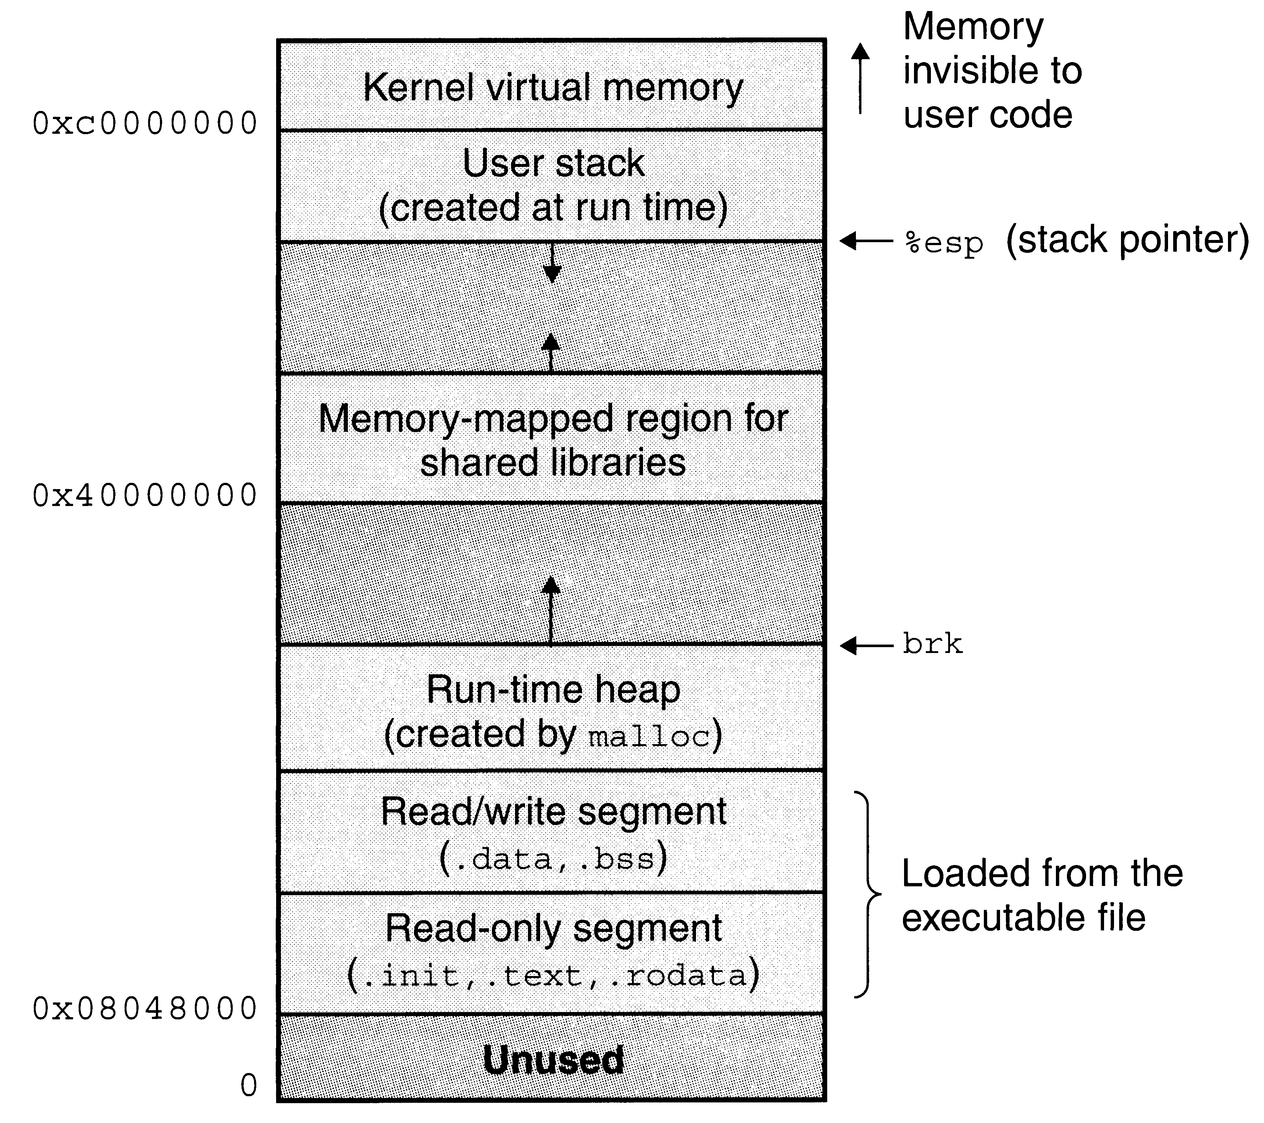
Linux Memory Image

Slide 10
Subroutines – Implementing Control Transfer
main(){
int n = getchar();
computerSqrSum(&n);
}
int computerSqrSum(int *pn) {
int i, sum = 0;
for(i =0; i<*pn; ++i )
sum = sum +sqr(i);
*pn = sum;
return sum;
}
int sqr(int n ) {
return n*n;
}

Slide 11
Subroutines – Implementing Control Transfer
void printReverse(char *str) {
char *lstr;
if( *str) { return; }
else {
lstr = str + 1;
printReverse(lstr)
}
putchar(*str);
}

Slide 12
Stacks and Subroutines – Implementing Control Transfer
Steps for calling a SubRoutine
Store the Link Register on the stack and adjust the stack Pointer.
Call the SubRoutine.
Pop the contents of the Link Register back from the stack and adjust the stack pointer.
Caller
Agreement: Caller promises callee to preserve stack contents, the sp and lr.
Callee
Instead of doing this for every Subroutine Call, why can’t we store the link register at the beginning of the Caller code and Restore it at the end.

Slide 13
Passing Parameters and Return Values
How to pass Parameters and Return Values?
Pass parameters through registers. If there are more parameters than available registers, pass the rest of the parameters through the stack.
Return Values?

Slide 14
Who should preserve the Registers?
Subroutine foo wants to call Subroutine fun.
Strategy 1: Before calling fun, foo stores all the registers it would like to preserve on the stack and restore them after the return from the function fun.
Strategy 2: fun simply calls foo and foo saves all the registers it would like to use on the stack and restores them back before the return to fun.
What are the pros and cons of the two approaches?
Here comes the idea of caller saved registers and callee saved registers.

Slide 15
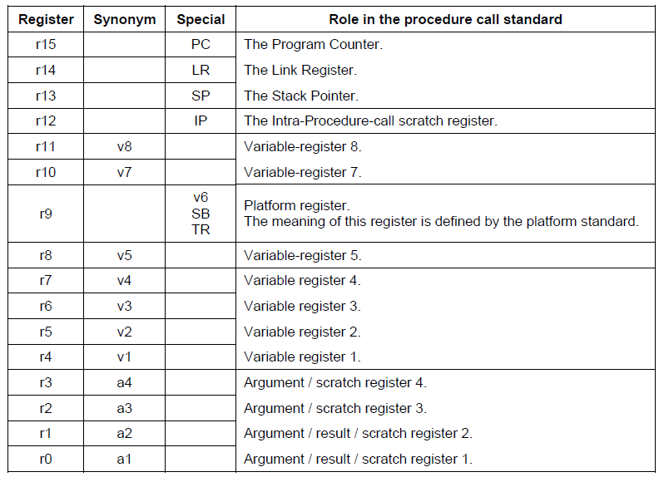
ARM Procedure Call Standard

Slide 16
ARM Procedure Call Standard
Preserved | Not Preserved
Variable Registers: r4 – r11 | Argument Registers: r0 – r3
Stack Pointer: sp | Intra-procedure-Call Scratch Register: r12
Link Register: lr | Stack below the stack pointer
Stack above the stack pointer
You may not strictly care for these conventions within your assembly code.
However you should pay attention to these guidelines when making library function calls.

Slide 17
Procedure Prologue and Epilogue Code
Consider a subroutine foo which not only needs the registers r0-r3, r12, but also requires three additional registers r4, r5, r6 to do its computation.
foo:
sub sp, sp, 16
str lr, [sp]
str r4, [sp, #4]
str r5, [sp, #8]
str r6, [sp, #12]
.
.
.
ldr r6, [sp, #12]
str r5, [sp, #8]
str r4, [sp, #4]
str lr, [sp]
add sp, sp, 16
Preserved | Not Preserved
Variable Registers: r4 – r11 | Argument Registers: r0 – r3
Stack Pointer: sp | Intra-procedure-Call Scratch Register: r12
Link Register: lr | Stack below the stack pointer
Stack above the stack pointer

Slide 18
Procedure Prologue and Epilogue Code
foo:
stmfd sp!, {r4-r6, lr}
.
.
.
ldmfd sp!, {r4-r6, pc}
Did you see this block data transfer instruction?
Preserved | Not Preserved
Variable Registers: r4 – r11 | Argument Registers: r0 – r3
Stack Pointer: sp | Intra-procedure-Call Scratch Register: r12
Link Register: lr | Stack below the stack pointer
Stack above the stack pointer

Slide 19
Procedure Calling Sequences
Procedure main wants to call foo. It passes its parameters through the registers r0 and r1. It is also using registers r2 and r3 for its local computation. So it has to make to sure the register contents r2 and r3 are preserved across the function call to foo. But how?
Preserved | Not Preserved
Variable Registers: r4 – r11 | Argument Registers: r0 – r3
Stack Pointer: sp | Intra-procedure-Call Scratch Register: r12
Link Register: lr | Stack below the stack pointer
Stack above the stack pointer

Slide 20
Storage Lay-out of a Program
Code (Procedures are stored here)
Data Segment (Global variables and static variables are stored here)
Heap (memory allocated through malloc calls come from here)
Stack (Activation records for procedure invocations are stored here)

Slide 21
Activation Records
A program is a life-less entity at compile time and in general until it is invoked. It gains life when it is executed.
Similarly a procedure in a program comes to life when it is invoked or activated.
Each Live (or Active!) Procedure during a program execution has an associated Data-Structure called Activation Record.
What does a Live Procedure need for it to carry out it business?

Slide 22
Activation Records
What does a Live Procedure need for it to carry out it business?
Space for its parameters
Space for the return value
Space for the Local Variables
Return address of the Calling Procedure.
Space to save the calling procedure context like registers etc.
Actual Parameters
Return Value
Saved Machine Status
Local Variables
Temporary Variables
Actual parameters and return values can be communicated through processor registers also.

